Slide 1

WHAT THE DUCKS
Gabrielle O-G
Aysha Sparks
Livia Throckmorton

Slide 2
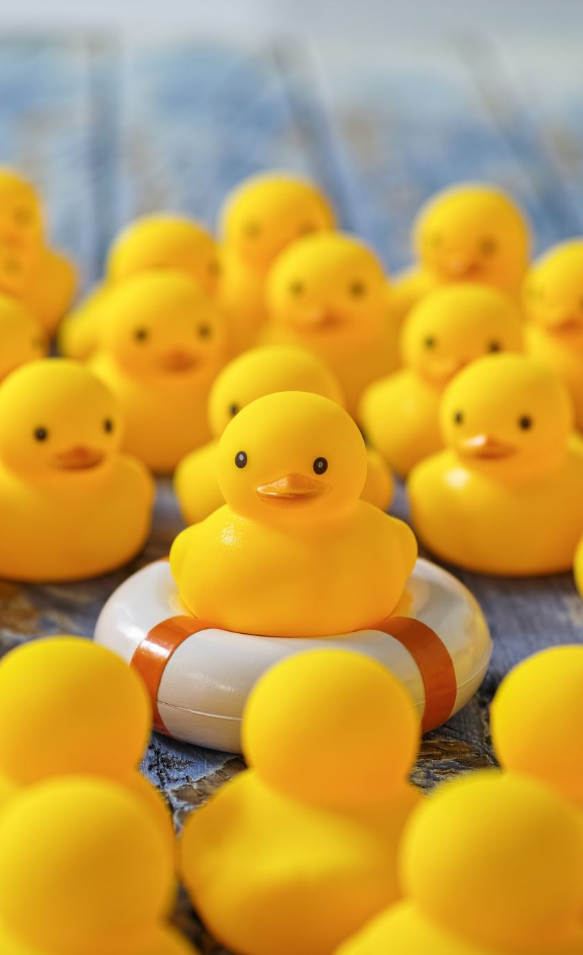
WHO WE ARE
At WHAT THE DUCKS, we harness creativity in the form of a fun dress up game. While much like other dress up games, Dress-Up Duck is where users can dress the duck with clothing items from its wardrobe.
We are strong advocates for instilling confidence in people, so we also have a Forum so users can share their outfits made and potentially comment on other users' ducks!

Slide 3
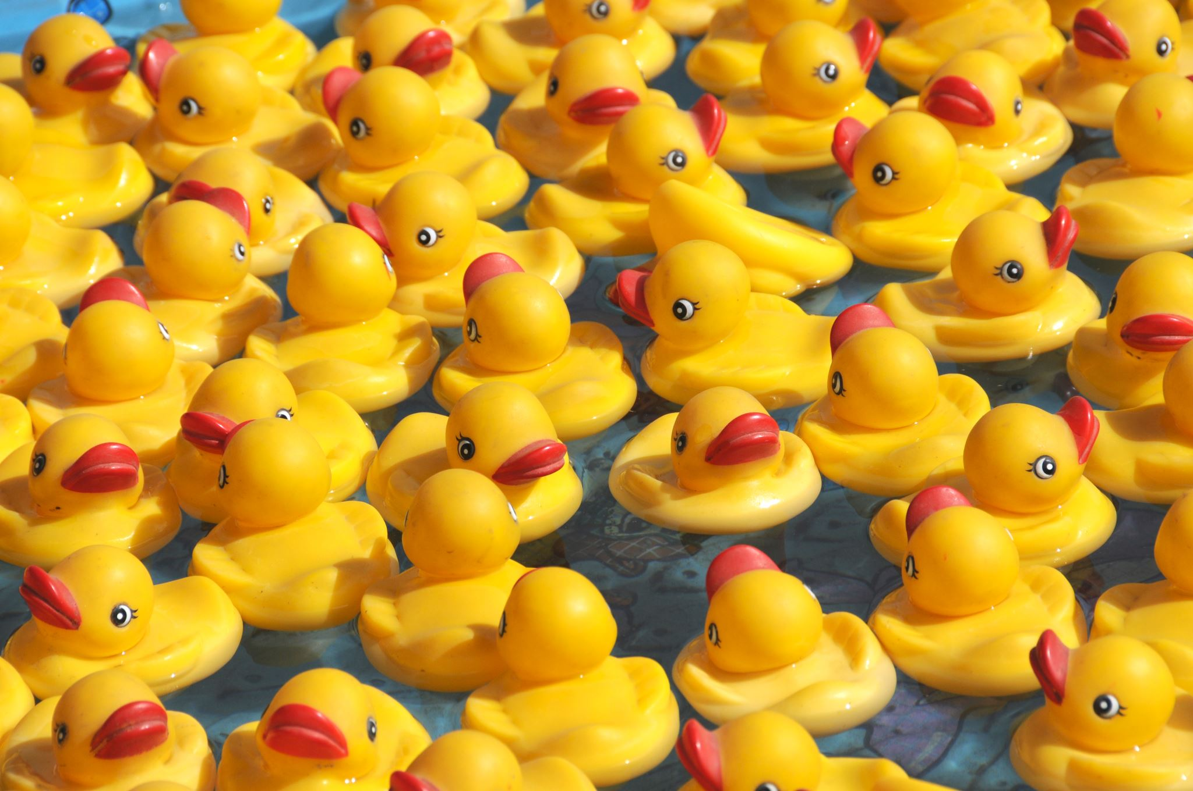
STUMBLING ACROSS PROGRAMMING

Slide 4



Programming ducks

Slide 5
As far as I'm concerned, playing 'Dress Up' begins at the age of 5, and never truly ends.
“
”
Kate Spade

Slide 6

Dress Up Duck
Our project is Dress-Up Duck. We will be using a variety of technologies to get our achieved outcome, which is a functional, fun, safe environment to express creativity!

Slide 7










Technologies Used
(& programs)

Slide 8
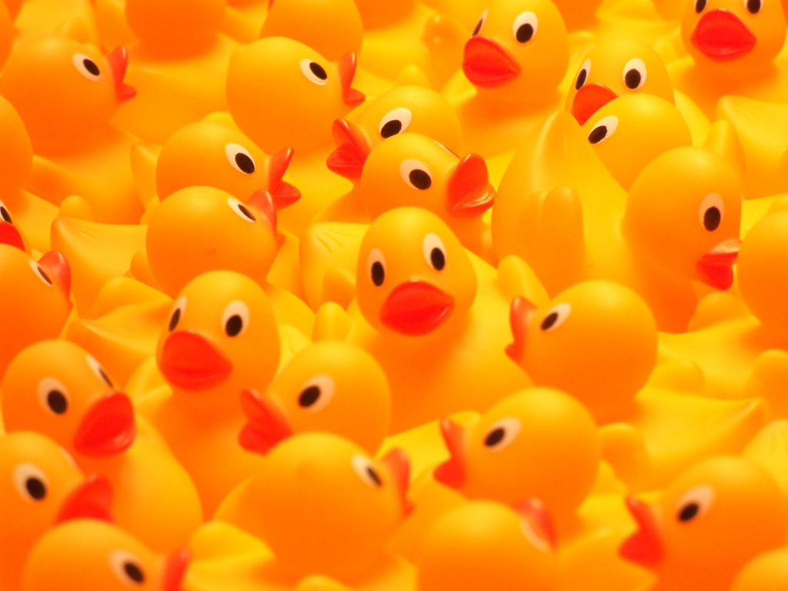
Live demo
Let's see how it works!

Slide 9

Thank you to Corbin & Dillon for their exemplary patience for our learning

